Slide 1



PROJECT SUMMARY
Presented By
RASHID ALI

Slide 2
Agenda
About the Project
Introduction
Data Desciption
RFM Model building
Model Implementation and Visualization

Slide 3
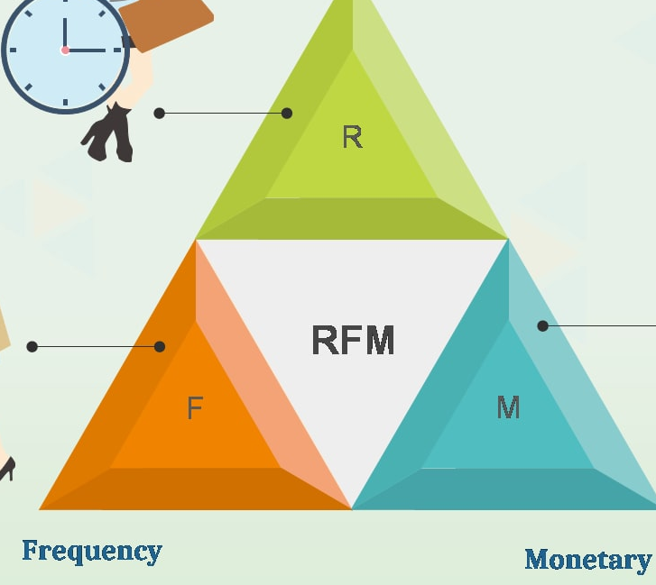
About the Project
• Identify potential customer segmentation using RFM model and provide some meaningful insights from each segment.
• What decision company should take based on the data insights?
• Prepare a PPT slide for the demonstration of your data modelling work.
• Demonstrate your understanding of the data.
• Do EDA (Exploratory Data Analysis) and provide a summary
• Explain your data modelling approach.
• What sort of modelling & segmentation is best fit for this data?
• lease find out the customers who are 'champions', 'Potential customers' and 'need attention'

Slide 4

Introduction
What is RFM Segmentation?
RFM analysis allows marketers to target specific clusters of customers with communications that are much more relevant for their particular behavior – and thus generate much higher rates of response, plus increased loyalty and customer lifetime value. Like other segmentation methods, an RFM model is a powerful way to identify groups of customers for special treatment. RFM stands for recency, frequency and monetary
Recency: How much time has elapsed since a customer’s last activity or transaction with the brand
Frequency: How often has a customer transacted or interacted with the brand during a particular period of time .
Monetary: Also referred to as “monetary value,” this factor reflects how much a customer has spent with the brand during a particular period of time .
4

Slide 5


Data Description
REVENUE
FREQUENCY
MONETARY

Slide 6
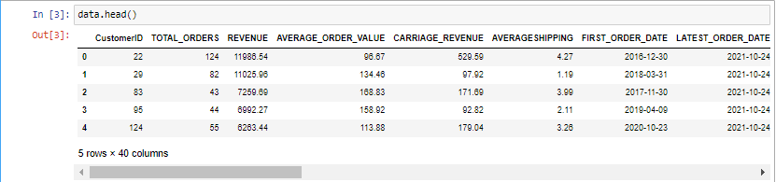
DATASET
Dataset is already cleaned(no missing values), correctly formatted and ready to be processed.
6

Slide 7
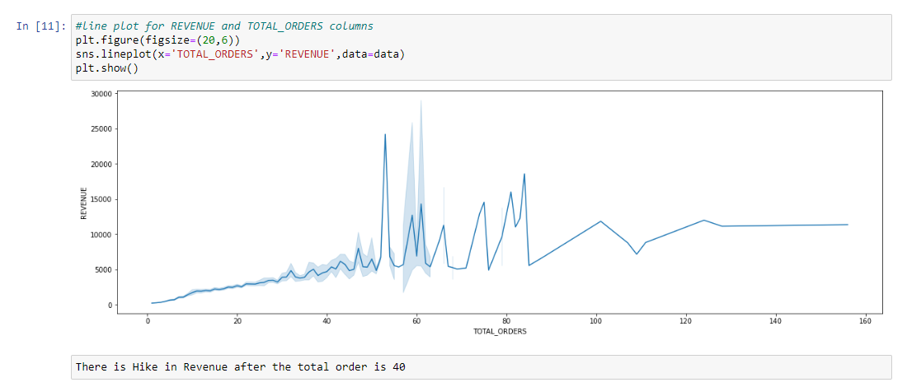
Performance of Customer
7

Slide 8
RFM Model
REVENUE
FREQUENCY
MONETARY

Slide 9
RFM stands for recency, frequency, monetary value. In business analytics, we often use this concept to divide customers into different segments, like high-value customers, medium value customers or low-value customers, and similarly many others. Recency: How recently has the customer made a transaction with us Frequency: How frequent is the customer in ordering/buying some product from us Monetary: How much does the customer spend on purchasing products from us. CUSTOMER SEGMENTATION: -Champions Customers: Bought recently, buy often and spend the most => recency-latest | frequency-high | momentary-high -Potential Customers: Recent customers with average frequency | recency-latest | frequency-avg -Need attention: Customer have => recency-low | frequency-low | low-monetary
9

Slide 10
Approach for Data Modelling
Extract Features
Scaling our Data
Generating RFM Score
Segmentation
Final Stage Data
For RFM model building first we need to do that we should extract the feature that we want for our model and that Features are :
CustomerID
DAYSSINCELASTORDER
AVGDAYSBETWEENORDERS
REVENUE
Normalizing the Data in the Similar Range so that our Model works better and Scalable in Future
Based on the Quartiles we can give score to R,F and M Columns. After that, to create a RFM score column we are adding the RFM together and this score is called RFM score.
Based on RFM Score we are Classifying the customer segmentation like Champion, Potential Customer and Need Attention Customers
Data is Finally Ready for the model implementation.
10

Slide 11
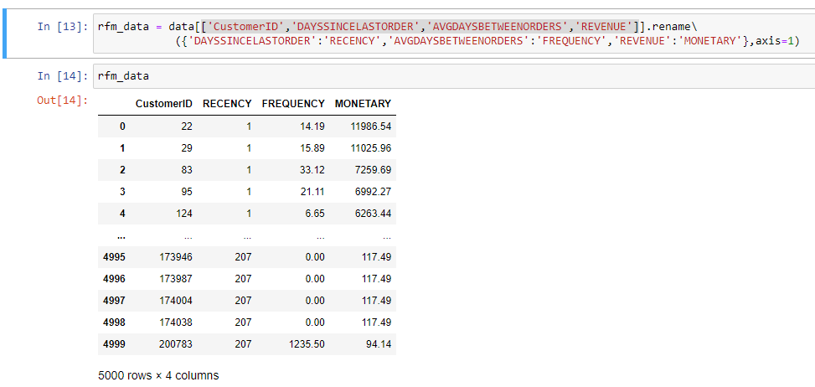
Extract Feature

Slide 12
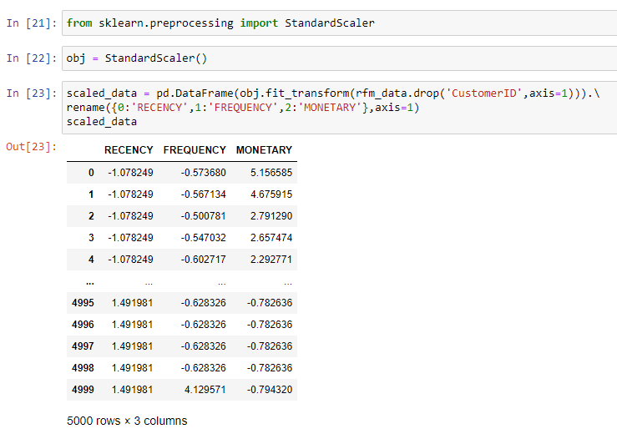
Scaling our Data

Slide 13
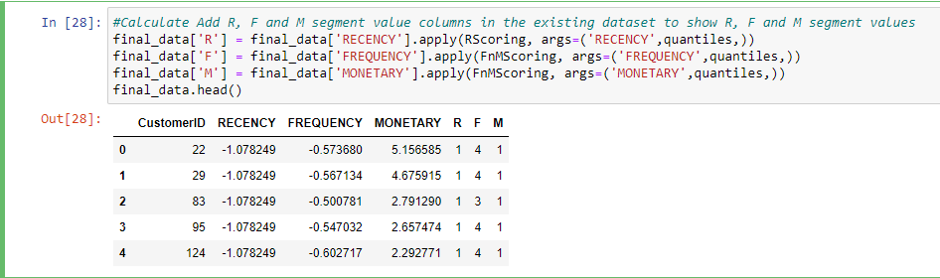
Generating RFM Score

Slide 14
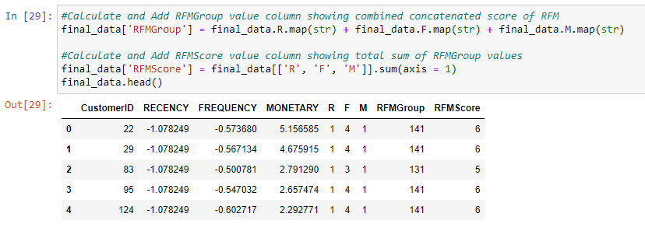
Segmentation

Slide 15
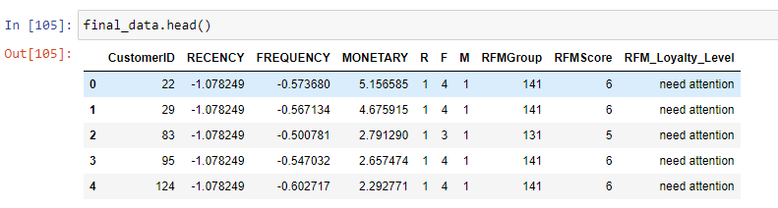
Final Stage Data

Slide 16
Model Implementation and Visualization
REVENUE
FREQUENCY
MONETARY

Slide 17
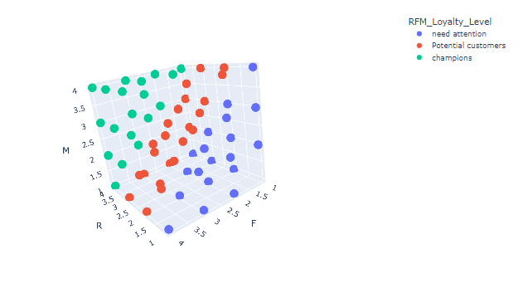
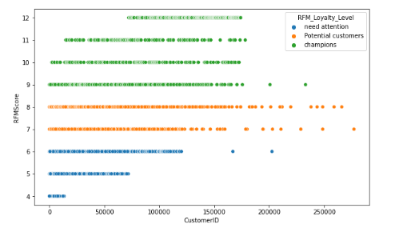
Some Visualization
From the graphs it is clearly seen that data is Linearly seperable and for classification data Logistic Regression is Best Fit.

Slide 18

About Logistic Regression
Logistic regression is a supervised learning classification algorithm used to predict the probability of a target variable. The nature of target or dependent variable is dichotomous, which means there would be only two possible classes.
In simple words, the dependent variable is binary in nature having data coded as either 1 (stands for success/yes) or 0 (stands for failure/no).
Mathematically, a logistic regression model predicts P(Y=1) as a function of X. It is one of the simplest ML algorithms that can be used for various classification problems such as spam detection, Diabetes prediction, cancer detection etc.
Logistic Regression can be used to classify the observations using different types of data and can easily determine the most effective variables used for the classification. The below image is showing the logistic function:

Slide 19
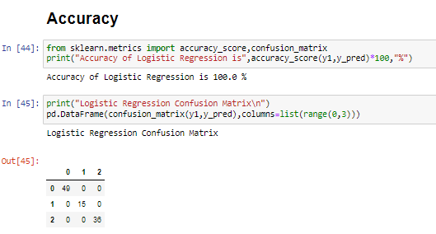
Apply Logistic Model
1. Applying Logistic regression model to our final stage Data.
2. First we need to split the Data in input and output column.
3. Train the Data
4. Then test the sample from data for accuracy.

Slide 20
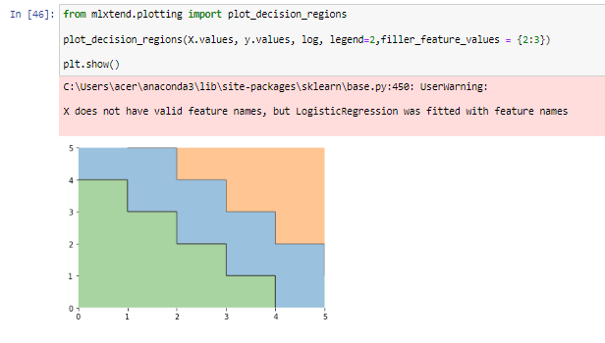
Decision Boundary

Slide 21

Areas of focus
B2B market scenarios
Cloud-based opportunities
Develop winning strategies to keep ahead of the competition
Capitalize on low-hanging fruit to identify a ballpark value
Visualize customer directed convergence
Iterative approaches to corporate strategy
Establish a management framework from the inside
21

Slide 22




Thank you

